Slide 1


PRIOR CRYPTO TRACKER WEB-APPLICATION
“NAVIGATING THE CRYPTOCURRENCY MARKET WITH CONFIDENCE”
Transforming crypto investing: Instant info, track the data, past trends, heightened security for users.
Presented by:
Date:
Riddhi Jain
Saloni Shrivastava
January 3, 2024

Slide 2






INTRODUCTION
Overview of Cryptocurrency Market:
In recent years, cryptocurrency has become an attractive investment option, enticing investors with the potential for substantial returns.
Cryptocurrency is a digital currency using cryptography to secure transactions.
Introduction to Prior Crypto Tracker
Prior Crypto Tracker web application is introduced as a solution to empower users in navigating the dynamic cryptocurrency market.
It is a solution addressing these needs, provides a user-centric approach to cryptocurrency tracking.

Slide 3









KEY FEATURES
Real-Time Data
Immerse yourself in the pulse of the market with live cryptocurrency prices, providing up-to-the-minute insights.
Chart.js Integration
Visualize trends like never before with Chart.js integration, bringing data to life for informed decision-making.
User-Friendly Interface
Designed for everyone – from seasoned professionals to crypto-curious beginners, our interface makes navigation a breeze.
Risk Management
Robust security measures, including Firebase authentication, to mitigate unauthorized access.

Slide 4




PROBLEMS WE SOLVE
Complexity
Inflexible Payment Options
High Fees
Challenges in Cryptocurrency Tracking: Market complexities make decision-making challenging for investors.
Manual Processes and Inefficiencies: Market complexities make decision-making challenging for investors.
Security Concerns: Risk of unauthenticated access poses a threat to user data.

Slide 5

OUR SOLUTION
By using the application in this project, anyone can get the updates andrequired information on various cryptocurrencies.
The ultimate goal of this project is to provide time to time updates on cryptocurrencies price.
Provide users with real-time insights and historical data for strategic decisions.
Simplify cryptocurrency tracking with an intuitive and accessible interface.
Implement Firebase authentication and stringent security rules for data integrity.

Slide 6


SYSTEM OVERVIEW
DESKTOP

Slide 7
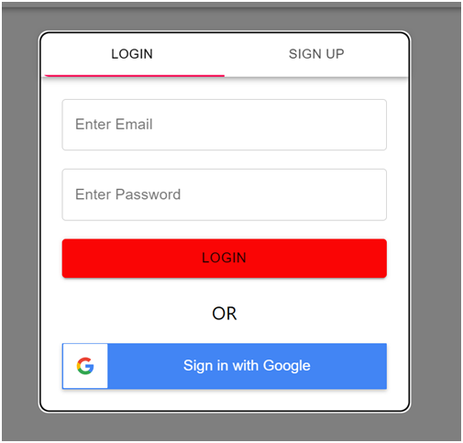
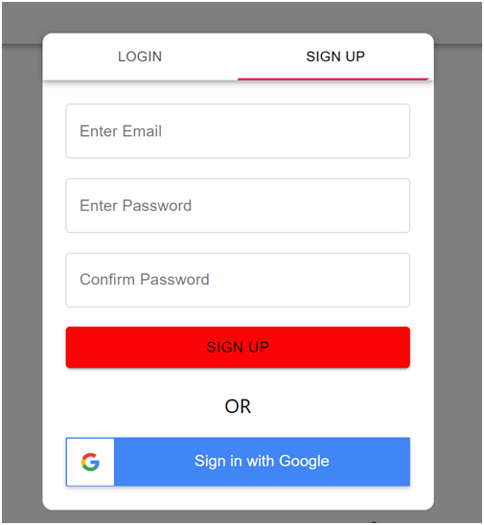

USER - AUTHENTICATION
Login
▪ Input: User name and password
▪ Output: Homepage

Slide 8
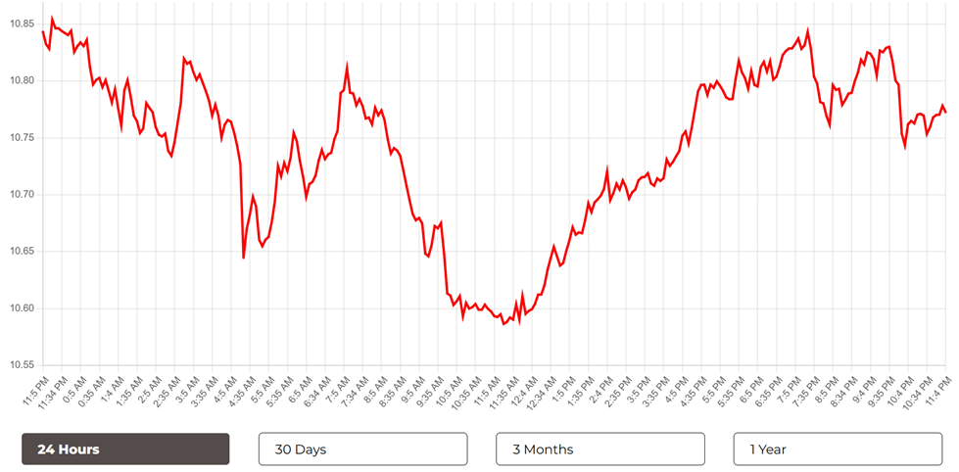
CRYPTOCURRENCY TRENDS
Utilizing the power of Chart.js for dynamic and interactive visualization of cryptocurrency trends over time ( 24 hrs, 30 days, 3 months & 1 year).
Equip users with the ability to analyze historical data, identify patterns, and make strategic investment decisions with confidence.

Slide 9
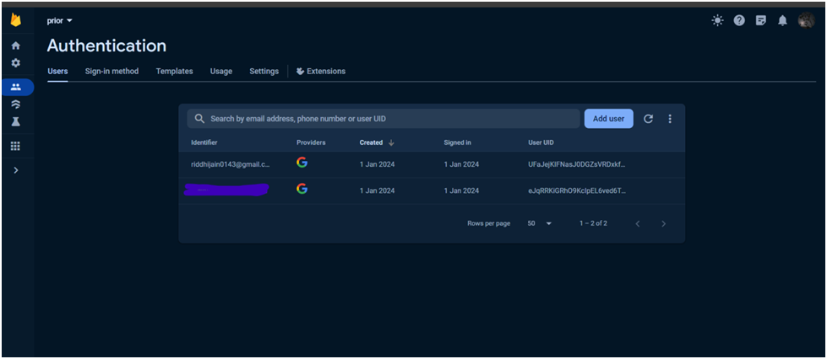
RISK MANAGEMENT
Prioritizing the integrity of user data through robust security measures, including Firebase authentication.

Slide 10
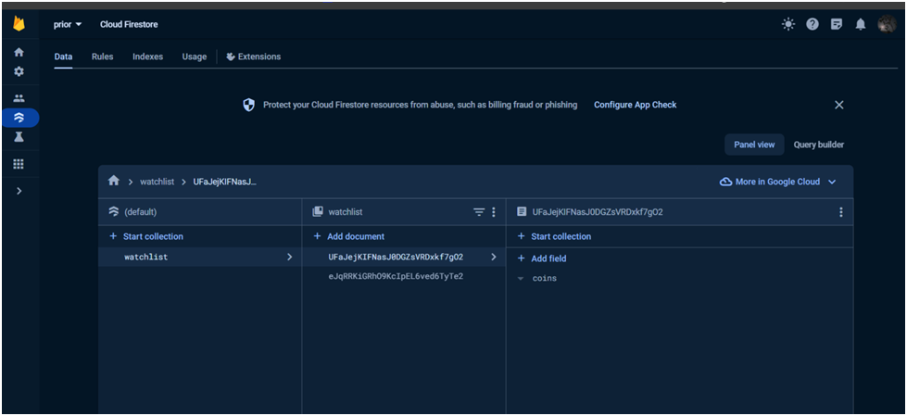
Mitigating the risk of unauthorized access by implementing and enforcing stringent security rules within the Firebase database.

Slide 11

PROJECT MANAGEMENT
Project Planning and scheduling:
Adopting an incremental software development model, where the system is developed and tested incrementally until all requirements are met.
Risk Planning:
Risk Identification: Unauthenticated users may gain access to the data and alter or misuse it, posing a significant risk to the project.
Risk Analysis: This is a serious risk because the data of the users is atrisk.
Risk Planning: The plan is to use the Firebase database's built-in securityrules. We can ensure that only registered and authenticated users can access (read, write, and update)the database by writing these security rules. Additionally,only logged-in users have access to their data.

Slide 12




TESTING
Testing Strategies:
Static Strategy
Description: Early-stage testing without running the product.
Purpose: Detect bugs and issues in the code and software structure.
Benefits: Avoid problems caused by code errors pre-deployment.
Structural Strategy (White-Box Testing)
Behavioral Strategy (Black-Box Testing)
Description: Testing with full access to software structure and data flows.
Purpose: Detect and correct bugs during pre-production, utilize regression testing.
Benefits: Automated process within a test automation framework.
Description: Testing the software's responses to various activities from a user's perspective.
Purpose: Evaluate product from the user's perspective, conduct usability tests.
Benefits: Includes automation for repetitive activities, focuses on user experience.

Slide 13

Homepage:
Purpose: After login, landing on the homepage with various features.
Expected Result: Successful navigation to the homepage.
Currency Button:
Purpose: Change currency for updated coin or token prices.
Expected Result: Prices displayed in the selected currency.
Search Bar:
Purpose: Search for a specific coin or token.
Expected Result: Successful retrieval of the searched asset.
Go to Next Page:
Purpose: Navigate to another page for tracking other currencies.
Expected Result: Successful transition to the next page.
Watchlist:
Purpose: Add or remove favorite coins or tokens from the watchlist.
Expected Result: Successful addition/removal, button color changes accordingly.
Coin Details:
Purpose: View detailed information and track prices through the graph.
Expected Result: Successful addition/removal to/from watchlist, accurate graph analysis.
TEST CASES OVERVIEW

Slide 14


PITCH DECK
FUTURE
FUTURE SCOPE
Q1
Q2
Q3
Q4
Q1
2FA
New Payment Methods
Leverages
Instant transfers
99.999% Uptime
Two-factor (2FA) authentication.
More than 80 new payment methods.
Greater profit potential for advanced users.
For an additional 0.5% fee for traders in a hurry.
24-hour trading volume every day of the year.

Slide 15
CONCLUSION
The value of each cryptocurrency is constantly changing, just like flat currency. This is exacerbated by the fact that cryptocurrency markets are open 24/7/365.
A “Prior” cryptocurrency portfolio is taht tool, allowing you to keep track of the performance of all of your cryptocurrencies and other assets in one place.

Slide 16

PITCH DECK
THANK YOU
THANK YOU
“NAVIGATING THE CRYPTOCURRENCY MARKET WITH CONFIDENCE”
Presented by:
Riddhi Jain
Saloni Shrivastava

